Slide 1
The Essence of What-if Assist – A Superb Modeling Application
What-if Assist (“WIA”) is a multi-faceted modeling Application with benefits that merit a home in every IBI WebFOCUS Toolbox! As such, it provides a User with a myriad of paths to Attainable Financial Goals.
With WIA Investment Analysis, every entity that produces new products or offers new services or requires new facilities, can achieve the goal-based measures of Break Even Income, Break Even Units, Return on Investment and Return of Capital within the confines of root variable limits. And if such limits inhibit the Attainable Financial Goal achievement, accept from the automatic options of Best Solutions.
With WIA Operating Analysis, every entity that issues current and comparable past performance Reporting Financials (indeed, virtually every member of the IBI WebFOCUS community – current and prospective) will appreciate the means to achieve the projection of Attainable Financial Goal performance looking forward. It does so by unmasking the usually hidden values of the root variables, by adding the limits that define the line item circumstances, and by introducing the ability to easily test a number of potential scenarios. And once more, the option remains to invoke Best Solutions when the occasion demands.

Slide 2
Investment Analysis Data
Variable | Value | Formula
Unit Price | 20 | N/A root
Unit Cost | 10 | N/A root
Total Units | 20,000 | N/A root
Selling Expense | 20,000 | N/A root
Research & Development (R_and_D) | 30,000 | N/A root
Overhead | 50,000 | N/A root
Revenue | 400,000 | Unit Price * Total Units
Variable Cost of Sales | 200,000 | Unit Cost * Total Units
Operating Expense | 90,000 | Selling Expense + R_and_D+ Overhead
Operating Profit | 110,000 | Gross Profit - Operating Expense
Break Even Units | 9,000 | Operating Expense / (Unit Price - Unit Cost)
Break Even Revenue | 180,000 | Unit Price * Break Even Units
Gross Profit | 200,000 | Revenue - Variable Cost of Sales

Slide 3
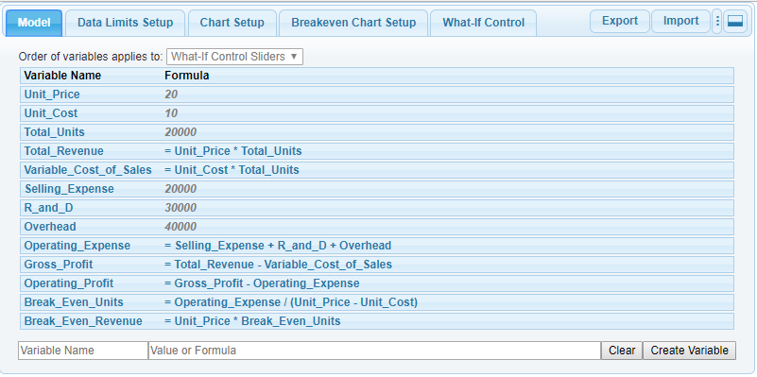
Investment Analysis Data in What-If Assist

Slide 4
Current Business Status
Break Even at 9,000 Units (the intersection of Revenue and Variable Cost) and Break Even Revenue at $180,000.

Slide 5
Defined Limits – The “Secret Sauce”
The exciting component of What-if Assist - the Benefit that distinguishes it from its Excel-based peers, is the Attainable Financial Goal achieved by confining root values to their practical limits of accomplishment. Call it "response to anticipated circumstance".
What-if competitive expectations will limit the range of a planned price change? What-if the minimum cost of sales can be affected by weather conditions at the projected period of launch? What-if ... ?
And when the defined limits are breached, where else except with What-if Assist is the User offered a range of Best Solutions?
And when else except with What-if Assist is the User protected from a false bottom-up reply?

Slide 6
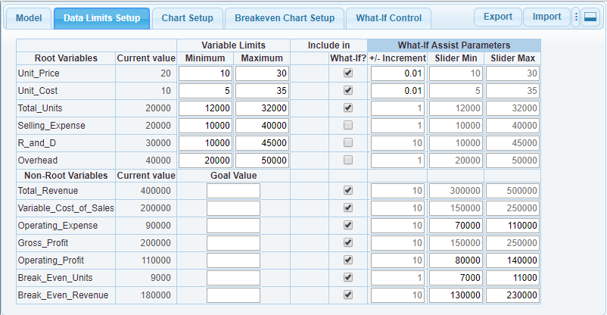
Data Limits Setup
Define min/max for each root variable.
Limits can be expressed as a fixed value or as a percentage below and above the current value.
The application provides default values of +/-10% of current value.
Optional: Define Goal values for non-root variables. The What-If Control tab will show a marker indicating the goal value in the slider panel.

Slide 7
Typical What-If-Based Examples:
Simple Top-Down What-If: What happens to Break Even Units and Break Even Revenue if Operating Expense is increased from 90,000 to 110,000?
Given the previous increase in Break Even Units from 9,000 to 11,000, how must Unit values be increased or decreased to maintain the current 9,000?
Could a further reduction in Unit Cost achieve the Goal of 5,000 Break Even Units?
Could a reduction in both Unit Cost & Operating Expense achieve a Goal of 5,000 Break Even Units – without violating original limits?

Slide 8
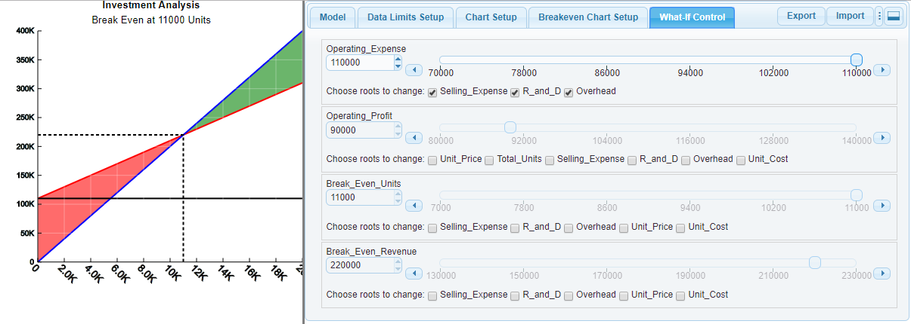
What happens to Break Even Units and Break Even Revenue if Operating Expense is increased from 90,000 to 110,000?
Check Selling Expense, R and D, and Overhead in the Operating Expense panel and drag the slider button to 110000
The increase in Operating Expense also increased Break Even Units & Break Even Revenue.

Slide 9
Given the previous increase in Break Even Units from 9,000 to 11,000, how must Unit values be increased or decreased to maintain the current 9,000?
Check Unit Price & Unit Cost in the Break Even Units panel and drag the slider button to 9000.

Slide 10
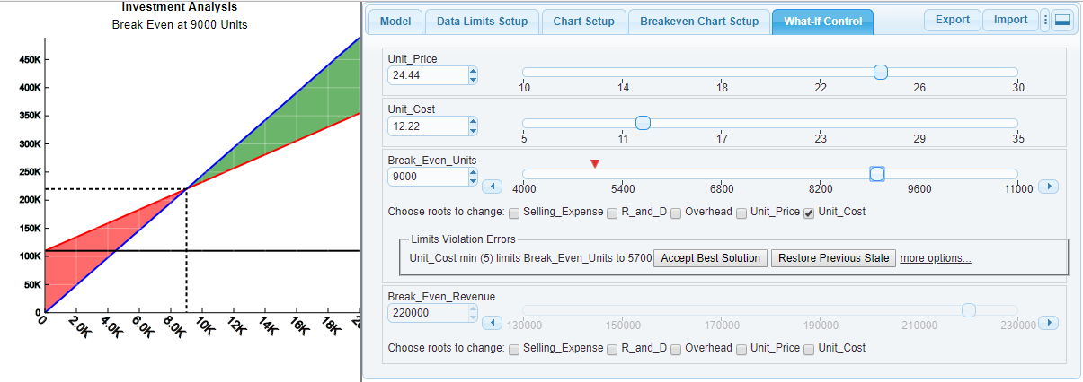
Could a further reduction in Unit Cost achieve the Goal of 5,000 Break Even Units?
Uncheck Unit Price in the Break Even Units panel and Click the Goal Marker
Limits Violation Errors: Click the Accept Best Solution button.
The Goal of 5,000 Break Even Units cannot be achieved with a reduction in Unit Cost alone without violating Unit Cost limits (Min/Max)

Slide 11
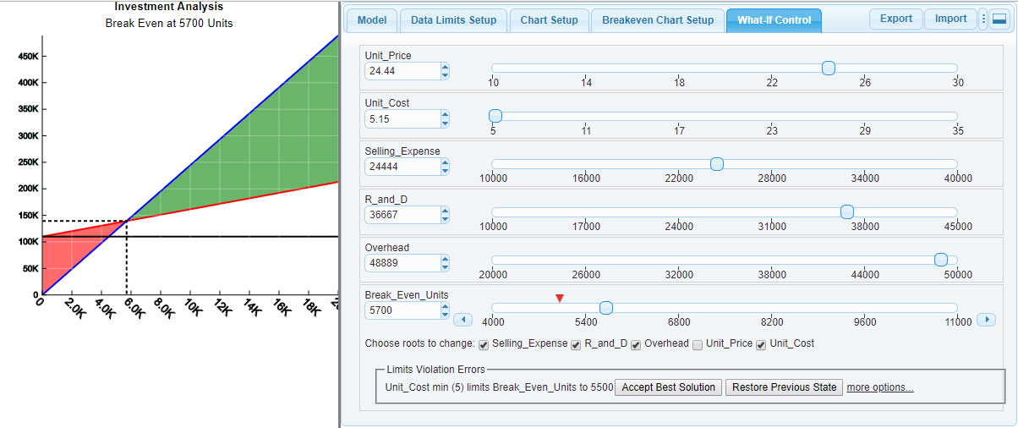
Could a reduction in both Unit Cost & Operating Expense achieve a Goal of 5,000 Break Even Units – without violating original limits?
Check Selling Expense, R and D, & Overhead in the Break Even Units panel and click the Goal Marker

Slide 12
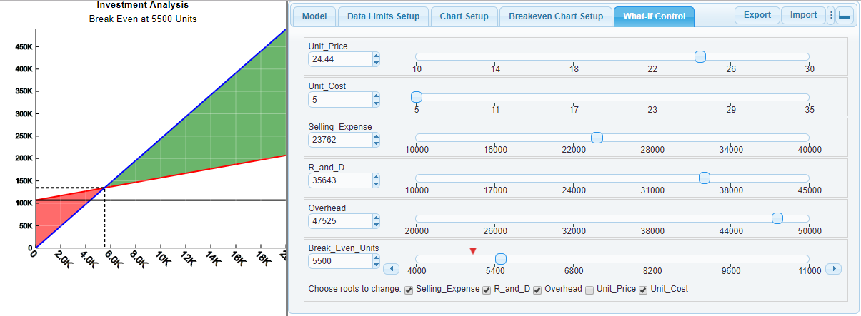
5500 Break Even Units is the best value that can be achieved in this scenario without breaching min/mix data limits.

Slide 13
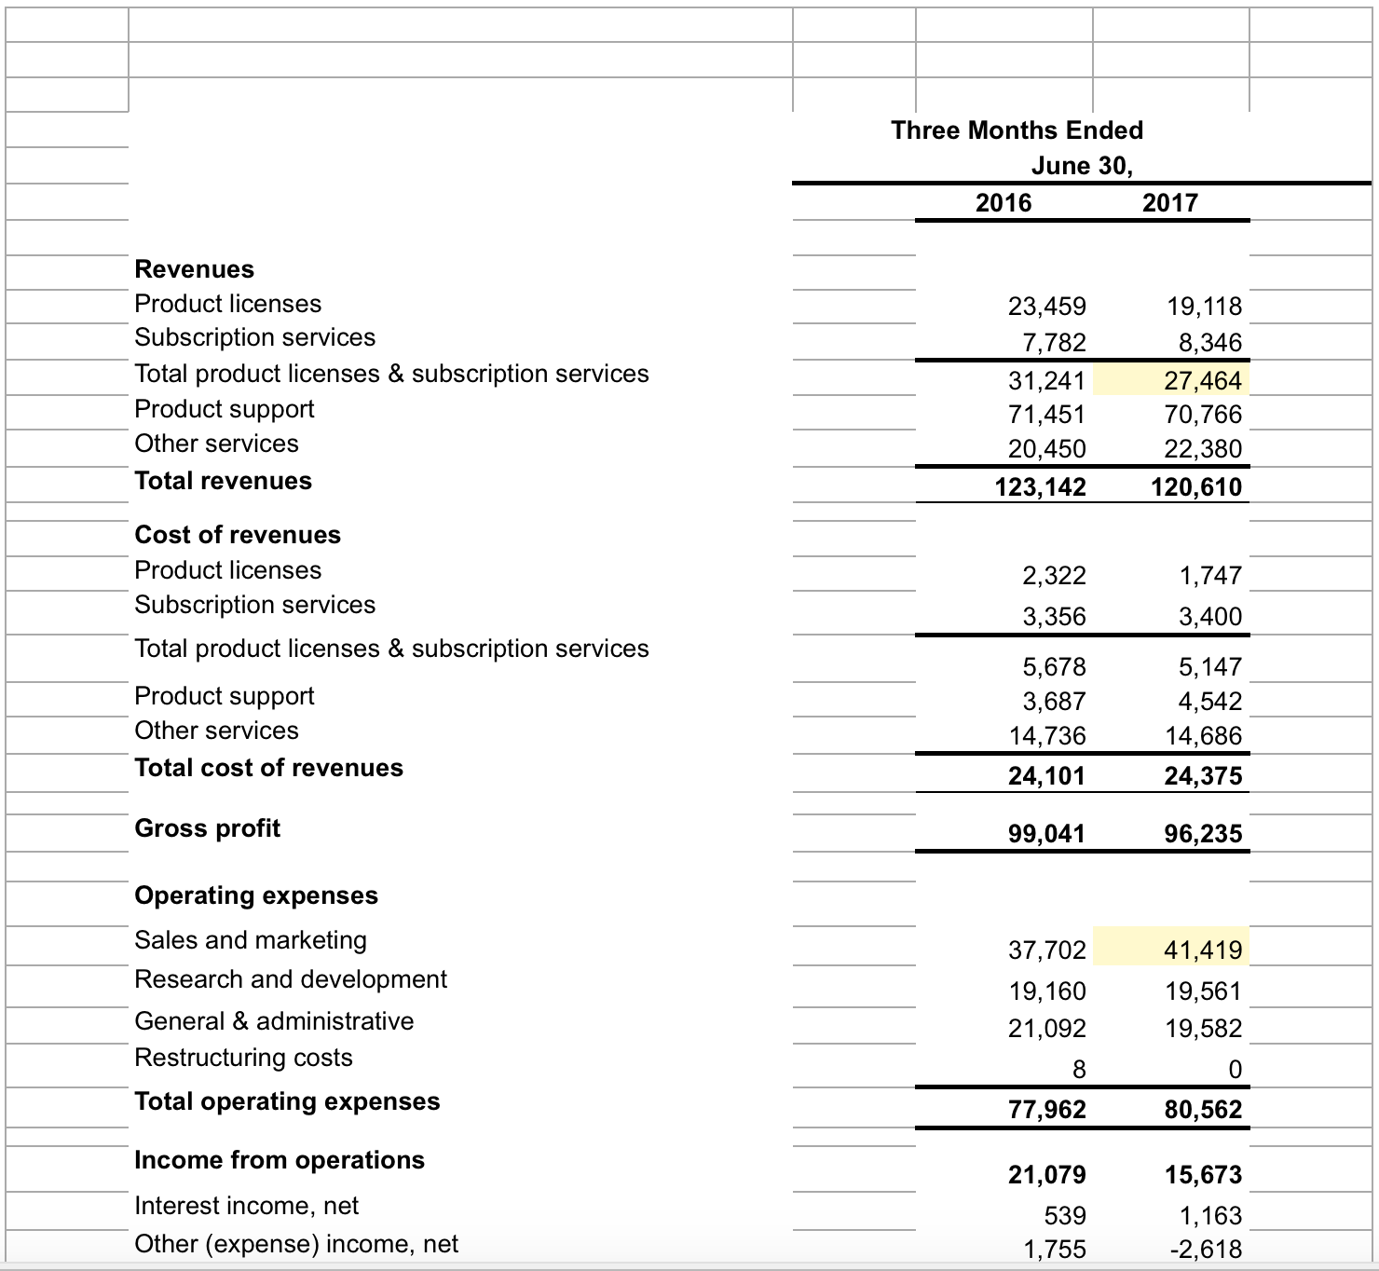
Operating Analysis Data
Not enough detail to do a proper analysis!

Slide 14
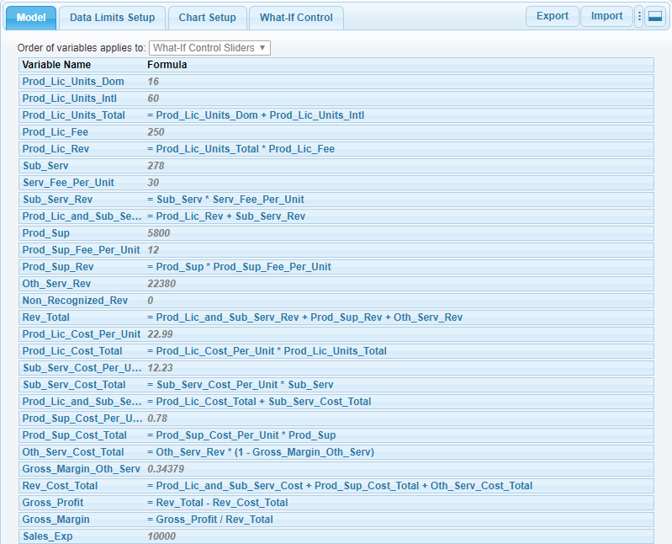
Operating Analysis Data in What-If Assist

Slide 15
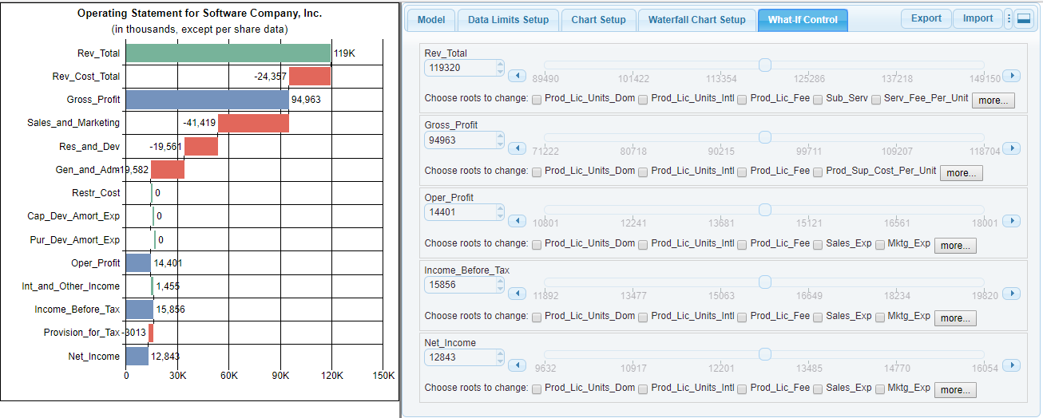
Operating Analysis Data in What-If Assist Waterfall Chart

Slide 16
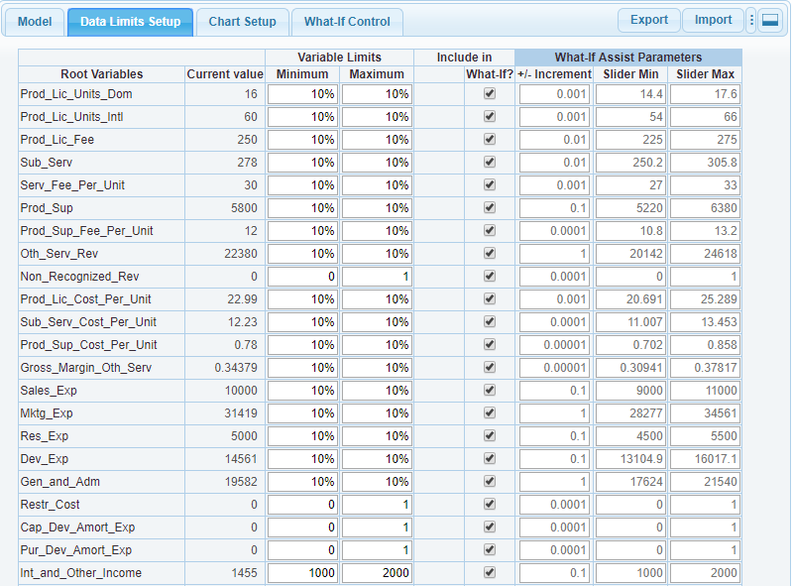
Define Limits Setup
Define min/max for each root variable.
Limits can be expressed as a fixed value or as a percentage below and above the current value.
The application provides default values of +/-10% of current value.
Optional: Define Goal values for non-root variables. The What-If Control tab will show a marker indicating the goal value in the slider panel.

Slide 17
Typical What-If Examples
1) How would it be if Revenues were increased by 10% (from 120K to 132K)? How would it affect profit: Gross Profit, Operating Profit, Income Before Tax, & Net Income?
2) How would a decrease in Revenue Costs affect profit: Gross Profit, Operating Profit, Income before Tax, & Net Income?
3) Could a decrease in Operating Expense achieve a Net Income Goal of 30K?

Slide 18
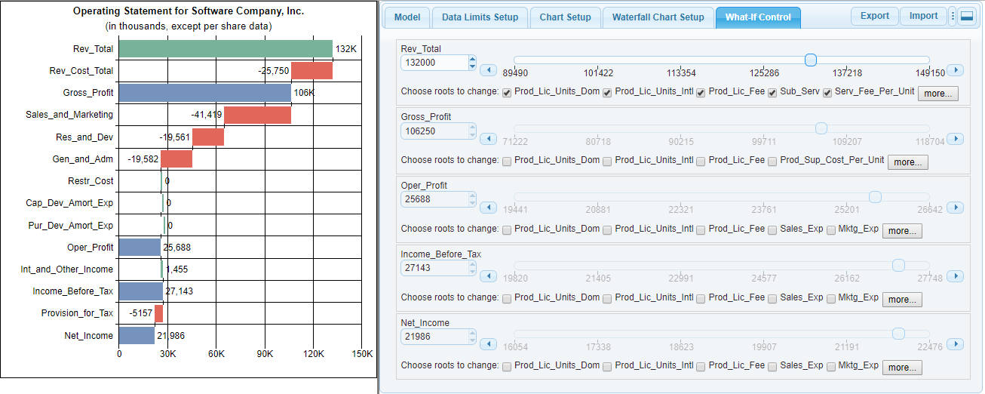
How would it be if Revenues were increased by 10% (from 120K to 132K)? How would it affect profit: Gross Profit, Operating Profit, Income Before Tax, & Net Income?
Rev_Total Choose roots to change: Click the More… button and check all root check boxes
Rev_Total: Drag slider button to 132000.

Slide 19
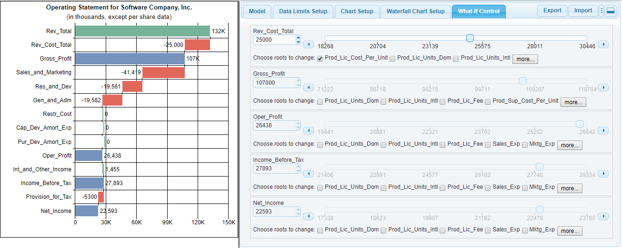
How would a decrease in Revenue Costs affect profit: Gross Profit, Operating Profit, Income before Tax, & Net Income?
Rev_Cost_Total: Check Prod_Lic_Cost_Per_Unit, Sub_Serv_Cost_Per_Unit, & Prod_Sup_Cost_Per_Unit.
Rev_Cost_Total: Drag slider button to 25000.

Slide 20
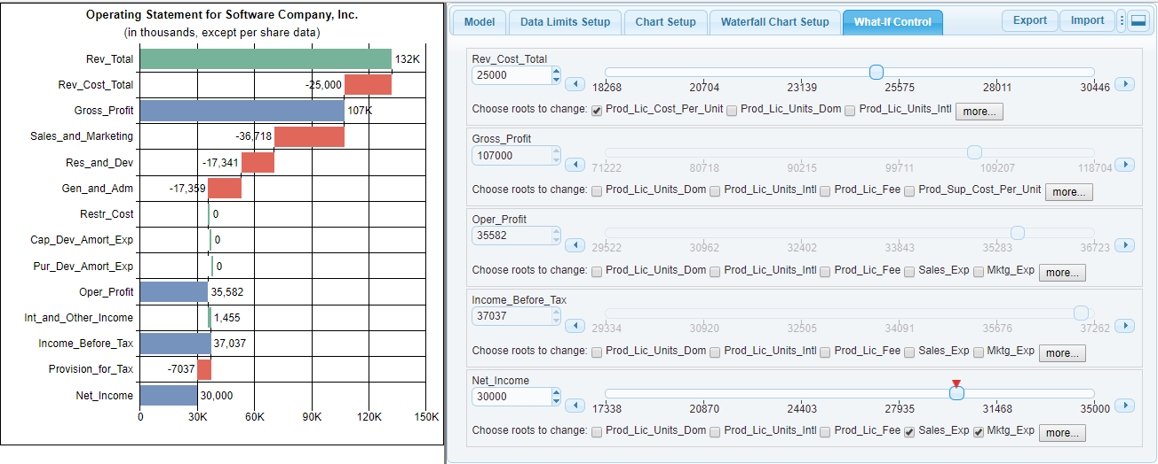
Could a decrease in Operating Expense achieve a Net Income Goal of 30K?
Net_Income: Click the More… button and Check Sales_Exp, Mktg_Exp, Res_Exp, Dev_Exp, & Gen_and_Adm.
Net_Income: Click the Goal marker.
All expenses are proportionately reduced to achieve the net income goal value.

Slide 21
Summary
The "practical assist" of What-if Assist is the information it provides to better determine the management decisions necessary at every relevant level in order to reach an Attainable Financial Goal.
The emphasis on root values and defined limits maybe unique in the business intelligence milieu. The undisputed value to every institution in this marketplace - whether Public or Private, is not unique.

