Slide 1
What-If Assist Setup
Companion Tool for Information Builders InfoAssist
Providing A Path to an Attainable Goal

Slide 2
What-If Assist Setup
What-If Assist can be used as an extension in the WebFocus InfoAssist environment or as a Standalone application.
WebFocus Extension
What-If Assist is available as an extension for users who have WebFocus 8.2 - earlier versions of WebFocus do not support extensions
Standalone
Allows a user to load their own data set via a .CSV file and perform What-If Analysis
The following slides describe how to:
Load data and setup What-If Assist as a WebFocus extension
Startup What-If Assist in Standalone mode

Slide 3
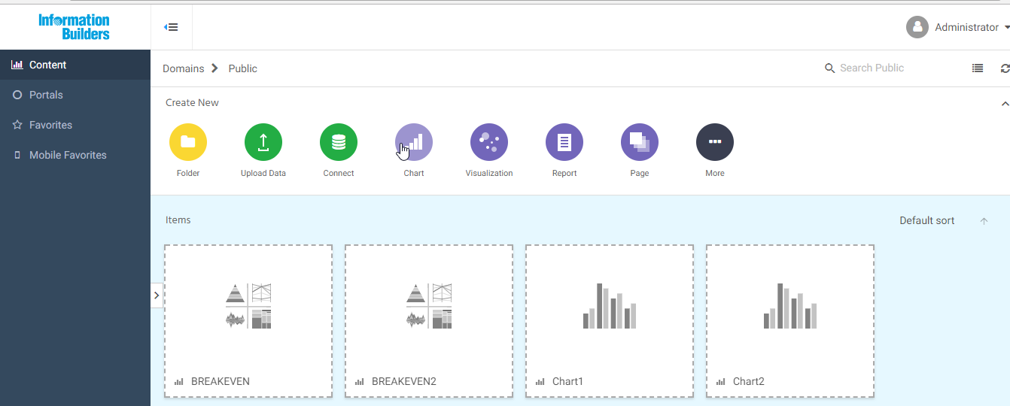
WebFocus Extension Setup
1) Click the Chart button in the WebFocus home page.

Slide 4
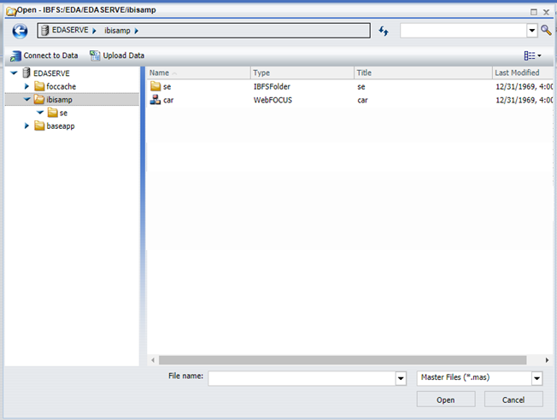
WebFocus Extension Setup
2) Choose a WebFocus master file or click Upload Data to import a .CSV or Excel file
NOTES:
Refer to WebFocus User Guide to Upload Data. The operation of What-If Assist is the same regardless of the source of data.
WebFocus does not support formulas in imported data in an Excel or .CSV file.

Slide 5
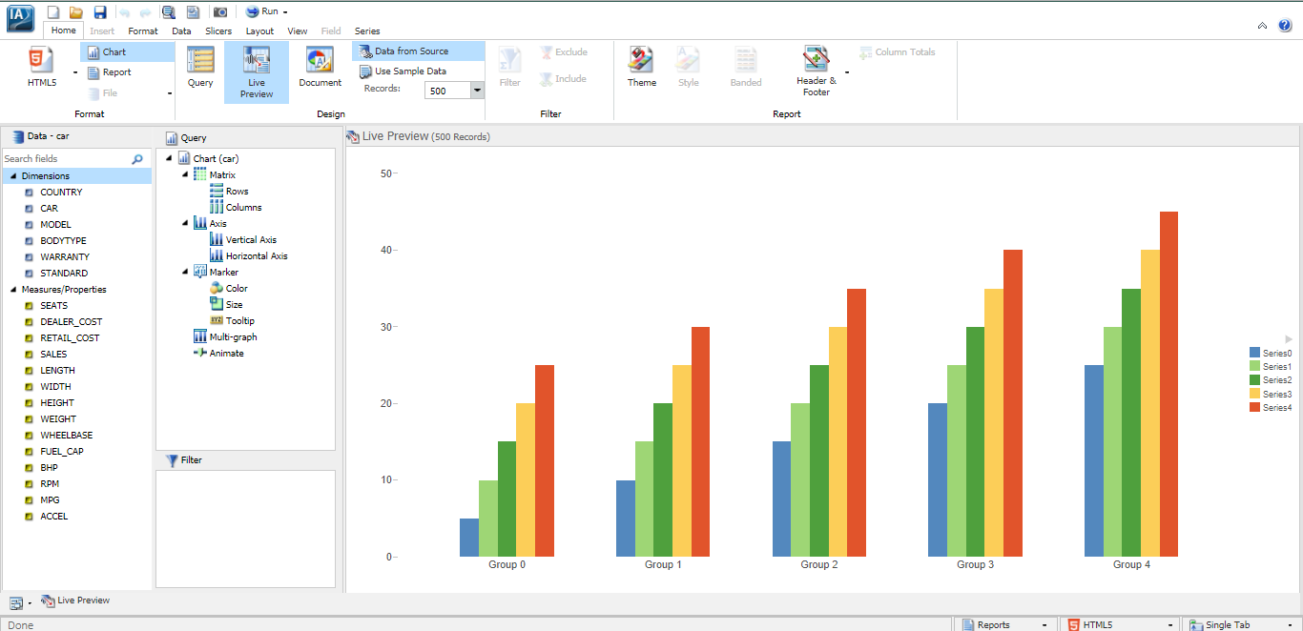
WebFocus Extension Setup
3) Variables from the selected master file or imported data are shown in the Measures column of the Data Panel of WebFocus InfoAssist.

Slide 6
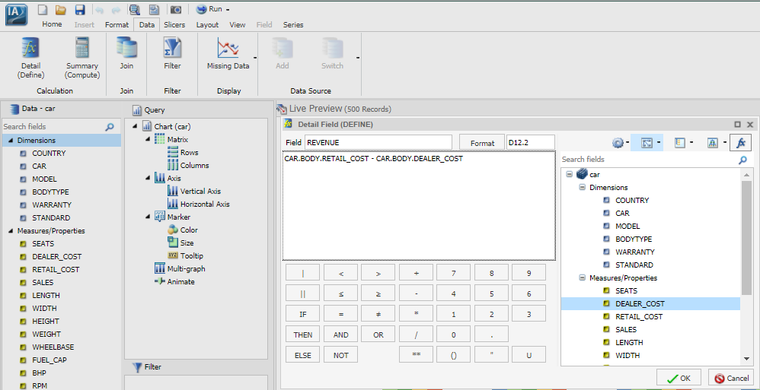
WebFocus Extension Setup
4) Use the Detail (Define) button in the WebFocus InfoAssist Data panel to define non-root/calculated variables.
NOTES:
Non-root/calculated variables are essential to What-If analysis. E.g., What would REVENUE be if DEALER_COST increased and RETAIL_COST decreased.
You may also define non-root variables and formulas in the What-If Assist Model Tab.

Slide 7
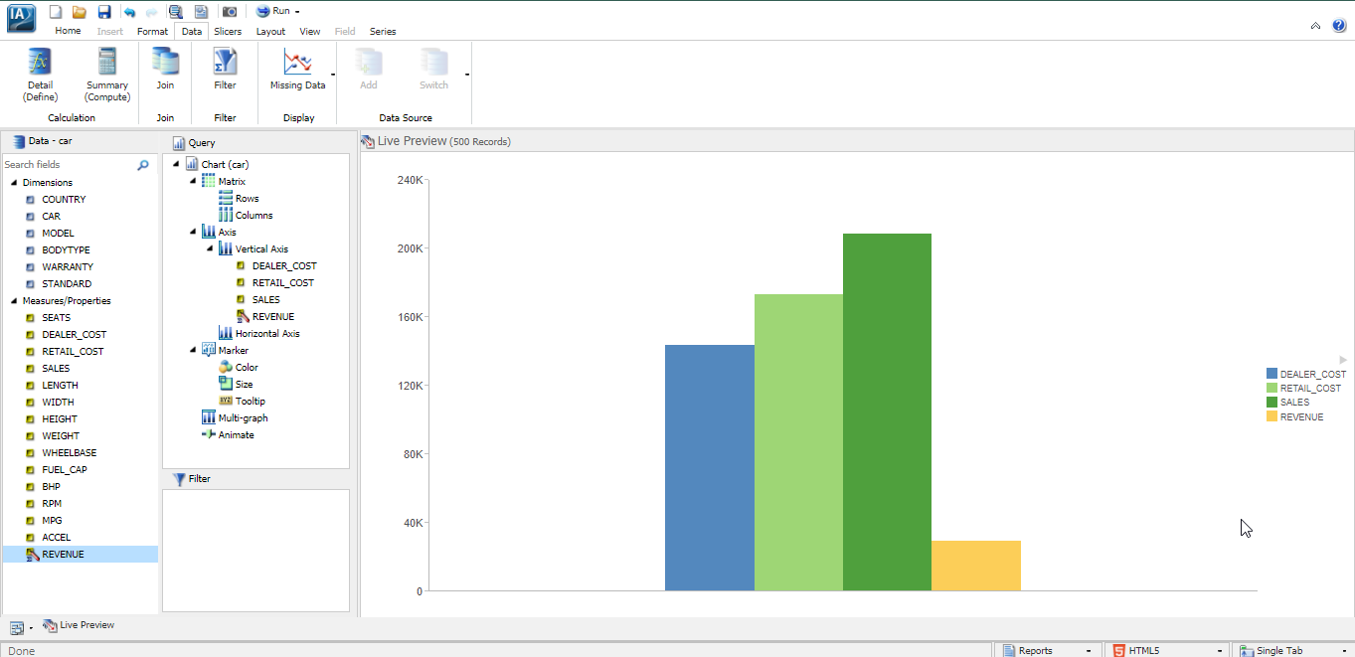
WebFocus Extension Setup
5) Double click or drag-and-drop one or more variables in the Measures column to add them to the default bar chart.

Slide 8
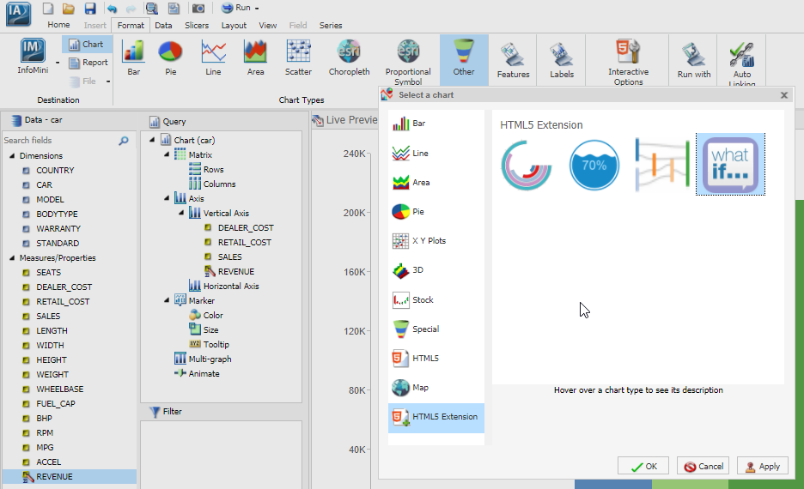
WebFocus Extension Setup
6) Click the Other button in the WebFocus Format tab. Click the HTML5 Extension button, choose the What If… icon, and click the OK button

Slide 9
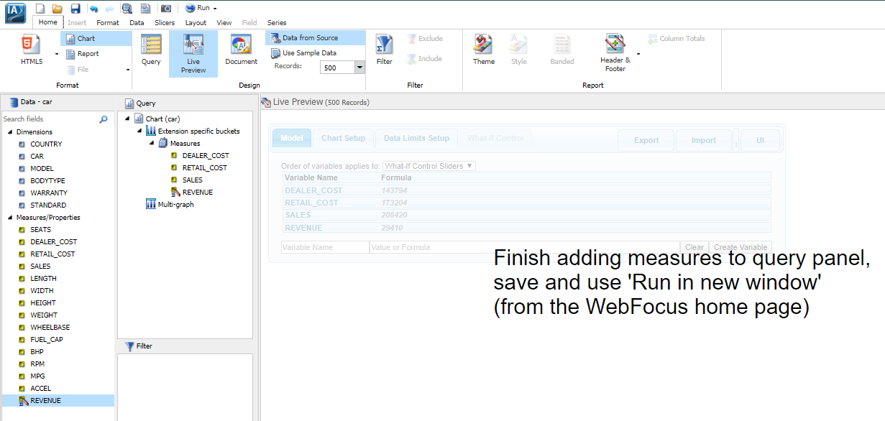
WebFocus Extension Setup
7) Click the Save button.

Slide 10
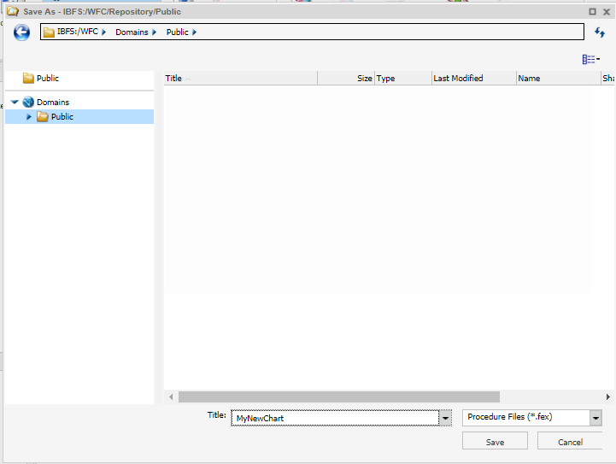
WebFocus Extension Setup
8) Enter a file name in the Title field and click OK.

Slide 11
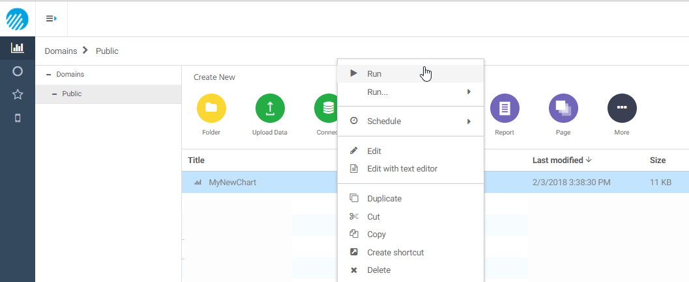
WebFocus Extension Setup
9) Return to the WebFocus Home page, right-click on the chart that was just saved, and select Run.

Slide 12
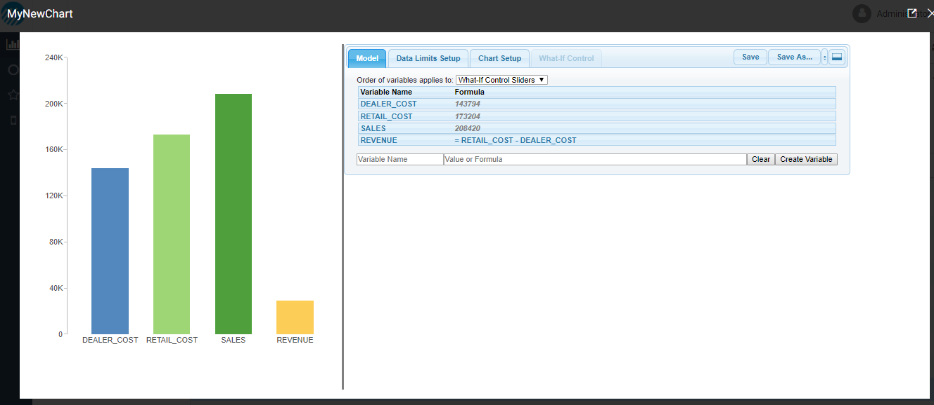
WebFocus Extension Setup
9) Click the Save button in the What-If Assist user interface panel to save the current state of the What-If Assist model.
Refer to the What-If Assist User Guide for information about how to use What-If Assist in the WebFocus environment.

Slide 13
Standalone Mode Setup
Open WhatIfAssist.htm in a browser.
Refer to the What-If Assist User Guide for information about how to use What-If Assist in Standalone Mode.

